Slide 1
Topic: Asymptotic Analysis
Design and Analysis of Algorithms
CSC 413
LECTURE 2
Lecture Note Presentation

Slide 2
Introduction to Asymptotic Analysis
Definition: Asymptotic Analysis is a mathematical method used to describe the efficiency of an algorithm as the size of its input grows very large. It helps us understand how efficiently an algorithm scales when handling large data sets.
Why it matters:
  Execution time depends on hardware, language, and compiler.
  Asymptotic analysis abstracts away these details, focusing purely on growth trends.
  It helps compare two algorithms objectively.
Example:
  Suppose we have two algorithms for searching in a list:
    Algorithm A: takes 5n steps .
    Algorithm B: takes 2n² steps.
    For small n, A and B might perform similarly, but as n grows large, n² grows much faster than n. see the graph
    Hence, Algorithm A is more scalable

Slide 3
Growth of Functions
The growth of a function describes how the runtime (or space usage) increases with the input size (n).
In algorithm analysis, we often approximate a function and drop lower-order terms and constants.
Common growth rates:
Type | Example Algorithm | Expression | Growth
Constant | Accessing array element | O(1) | Doesn’t grow
Logarithmic | Binary search | O(log n) | Grows slowly
Linear | Linear search | O(n) | Grows proportionally
Quadratic | Bubble sort | O(n²) | Grows fast
Cubic | Matrix multiplication | O(n³) | Grows very fast
Exponential | Recursive Fibonacci | O(2ⁿ) | Grows extremely fast
Next

Slide 4
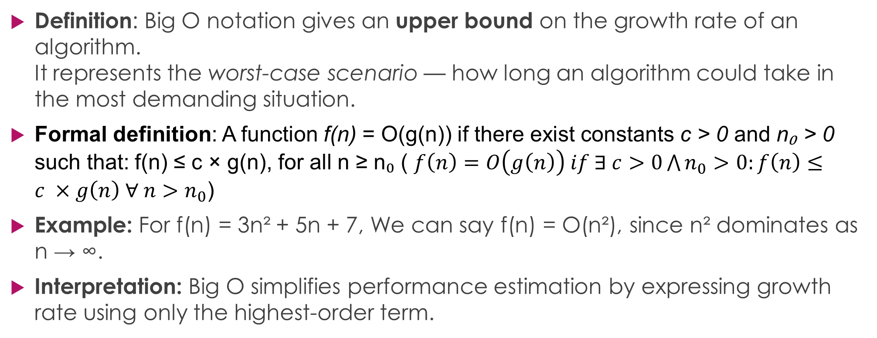
Big O Notation (Upper Bound)
Definition: Big O notation gives an upper bound on the growth rate of an algorithm.
It represents the worst-case scenario — how long an algorithm could take in the most demanding situation.
Formal definition: A function f(n) = O(g(n)) if there exist constants c > 0 and n₀ > 0 such that: f(n) ≤ c × g(n), for all n ≥ n₀ ( $f\left(n\right)=O\left(g\left(n\right)\right) if ∃ c>0\bigwedge{n_{0}}>0:f\left(n\right)≤c ×g\left(n\right) ∀ n>n_{0}$)
Example: For f(n) = 3n² + 5n + 7, We can say f(n) = O(n²), since n² dominates as n → ∞.
Interpretation: Big O simplifies performance estimation by expressing growth rate using only the highest-order term.

Slide 5
Big Ω (Omega) Notation (Lower Bound)
Definition: Big Ω provides a lower bound on the growth rate of an algorithm. It represents the best-case performance — the minimum time or resources required.
Formal Definition: A function f(n) = Ω(g(n)) if ∃ constants c > 0 and n₀ > 0 such that: f(n) ≥ c × g(n), for all n ≥ n₀
Example: For f(n) = 3n² + 5n + 7, f(n) = Ω(n²), since n² is also a valid lower limit.
Interpretation: Ω tells us the best we can expect from an algorithm’s efficiency.

Slide 6
Big Theta (Θ-notation) — Tight Bound
Definition: Big Theta provides a tight bound, meaning both the upper and lower bounds are of the same order.
Formal definition: f(n)=Θ(g(n)) if f(n)=O(g(n)) and f(n)=Ω(g(n))
Meaning: It gives an exact asymptotic order. Describes the typical or average case growth.
📘 Example: If f(n)=3n²+2n+5, f(n)=Θ(n²) because n² dominates both upper and lower bounds.
Interpretation: The running time grows exactly proportional to n² for large n.

Slide 7
Upper, Lower, and Average Complexity Bounds
Bound | Symbol | Meaning | Describes | Example
Upper Bound | O(g(n)) | ≤ limit | Worst-case growth | Bubble Sort = O(n²)
Lower Bound | Ω(g(n)) | ≥ limit | Best-case growth | Bubble Sort = Ω(n)
Average Bound | Θ(g(n)) | ≈ limit | Typical growth | Merge Sort = Θ(n log n)
Time
↑
| / ← Upper Bound O(g(n))
| /
| /
| / ← Average Bound Θ(g(n))
| /
|/______________________ ← Lower Bound Ω(g(n))
Input size (n)
Ω (Lower bound): Algorithm can never run faster than this.
O (Upper bound): Algorithm will never be slower than this limit.
Θ (Average bound): Algorithm typically performs around this r

Slide 8
Uses of Asymptotic Notations
Algorithm Efficiency Comparison — Asymptotic notations help us choose efficient algorithms for problem-solving by analyzing their complexities.
Predicting Performance — Asymptotic notations estimate the performance of algorithms for significant inputs by modeling their runtime and space requirements.
Algorithm Design — Asymptotic notations lead to efficient algorithms needed for problem-solving.

Slide 9
Limitations of Asymptotic Notations
While asymptotic notations are powerful tools, they have limitations. Here are a few examples:
  Ignoring Constant Factors — Asymptotic notations ignore constant factors impacting performance because they describe the long-term growth rate of functions rather than absolute magnitude.
  Measuring Small Inputs — Asymptotic notations assume input size grows infinitely. As a result, they may not show accurate performance for smaller inputs. Higher complexity algorithms may outperform lower complexity ones for small inputs.
  Precise Performance Measurement — Asymptotic notations do not consider data structure, hardware, and other factors.

Slide 10
Sample Exercise Questions
Prove that 5n³+3n²+2n+8=O(n³).
Compare the growth of n² and 2n² for n=1 to n=20 using Python.
Write a Python program to compute and plot the running times of sorting algorithms for increasing n.
Explain why asymptotic notation ignores constants and lower-order terms.
Discuss a real-world scenario where an algorithm with a smaller constant factor but higher asymptotic order performs worse.

Slide 11
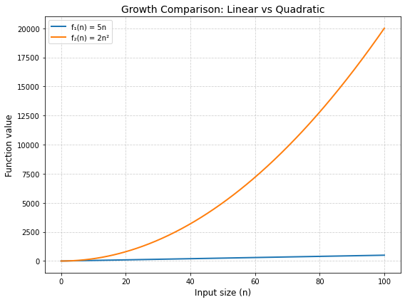
Linear vs Quadratic
Back

Slide 12
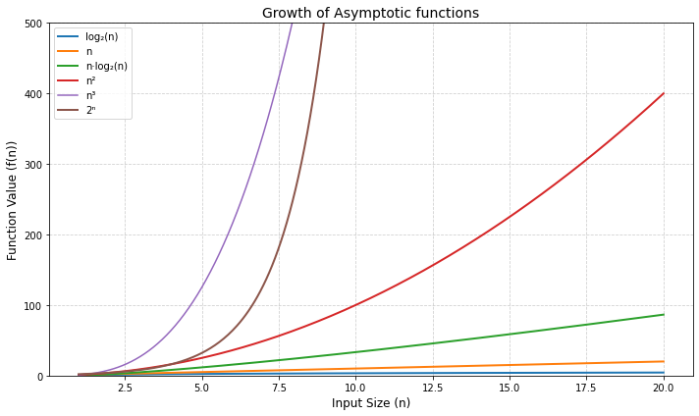
Comparison of Function Growth Rates
Back

